Slide 1

Weekly Progress
GE1.02 Shang-Wei Chang
2025/11/15

Slide 2


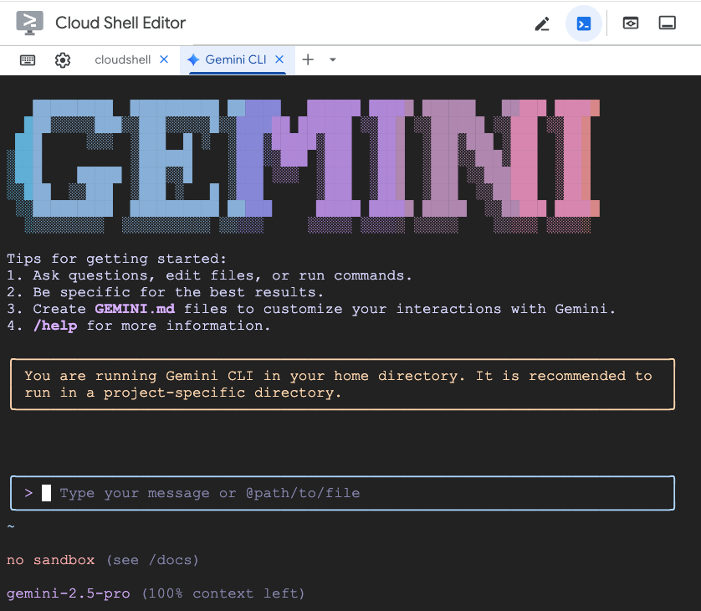
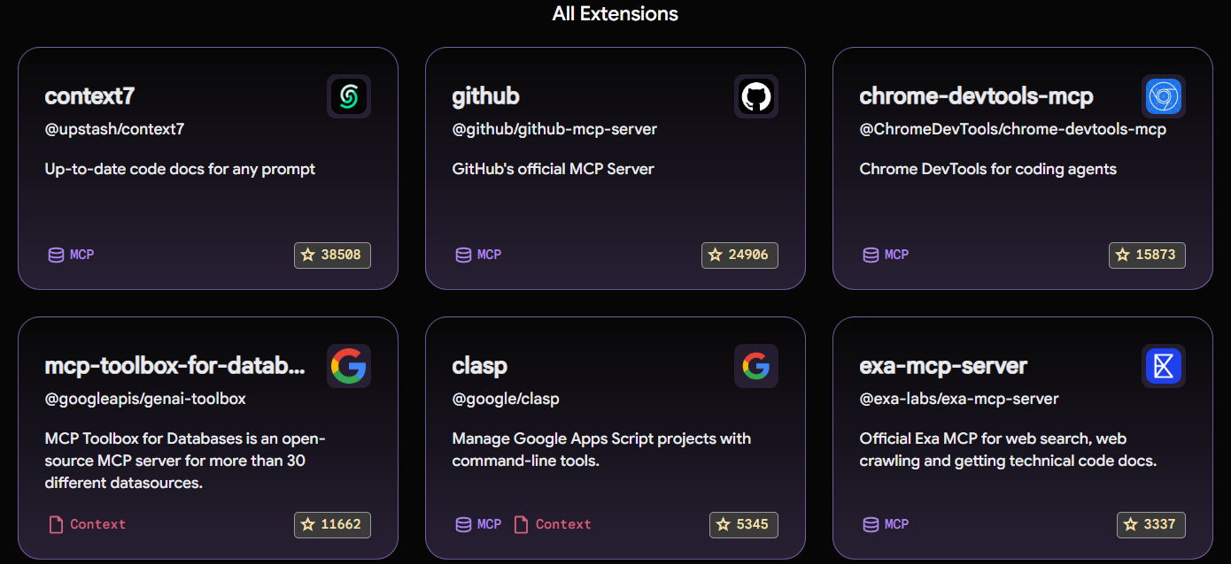

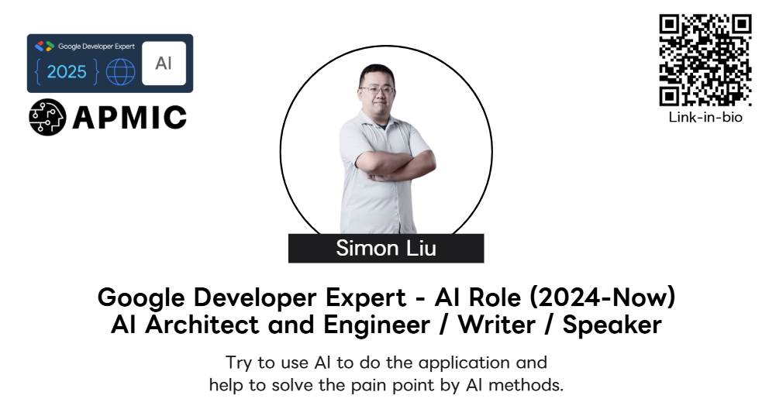
Devfest Taipei 2025
Google Devfest Taipei 2025 focuses heavily on AI & Machine Learning (specifically Gemini applications), Google Cloud, Mobile (Android & Flutter), and Web technologies.

Slide 3
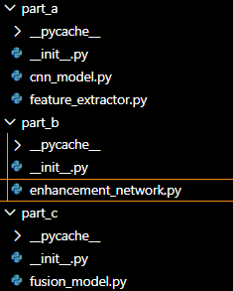
The Problem: Currently, main.py buffers raw video frames (e.g., 256 frames). When the buffer is full, it passes theentire list of 256 frames to extract_rppg.
The FeatureExtractor then runs MediaPipe face detection on all 256 frames again for every single new frame of video captured.
Result: This will cause the system to run at an extremely low frame rate (likely < 1 FPS) and lag significantly.

Slide 4
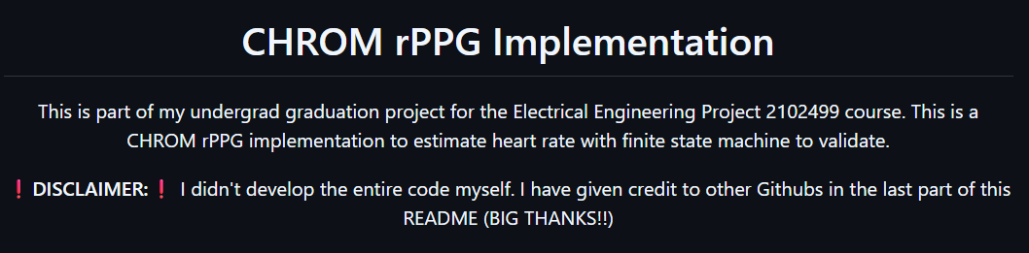
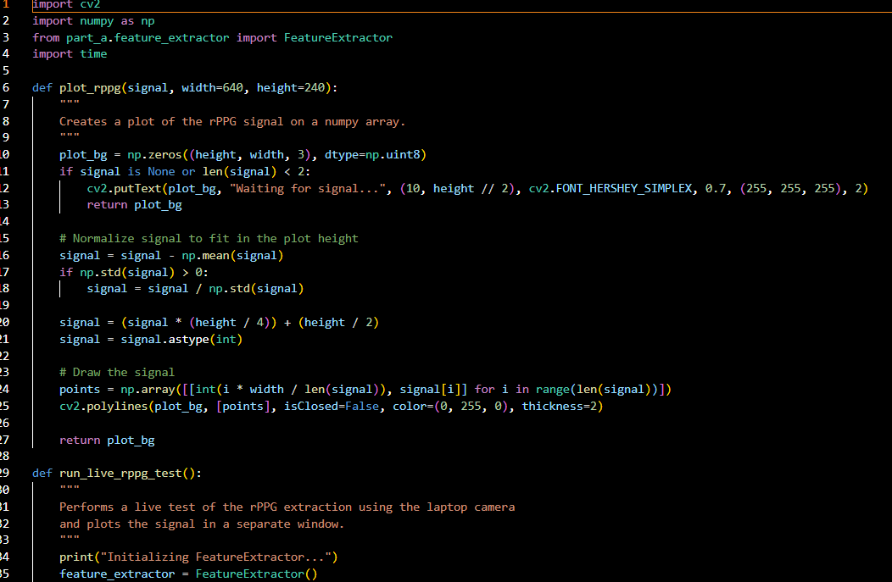
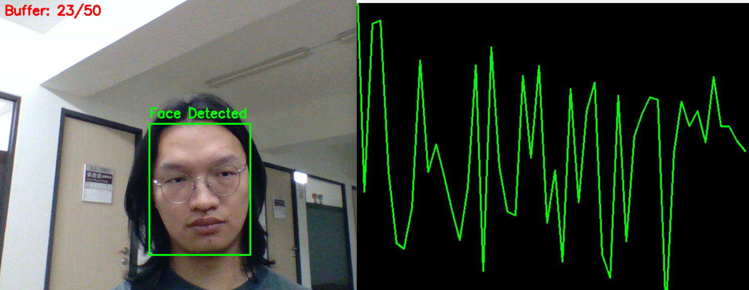
For rppg extraction I mainly uses Chrom rPPG. I had created a test program and run.
This is last week.

Slide 5
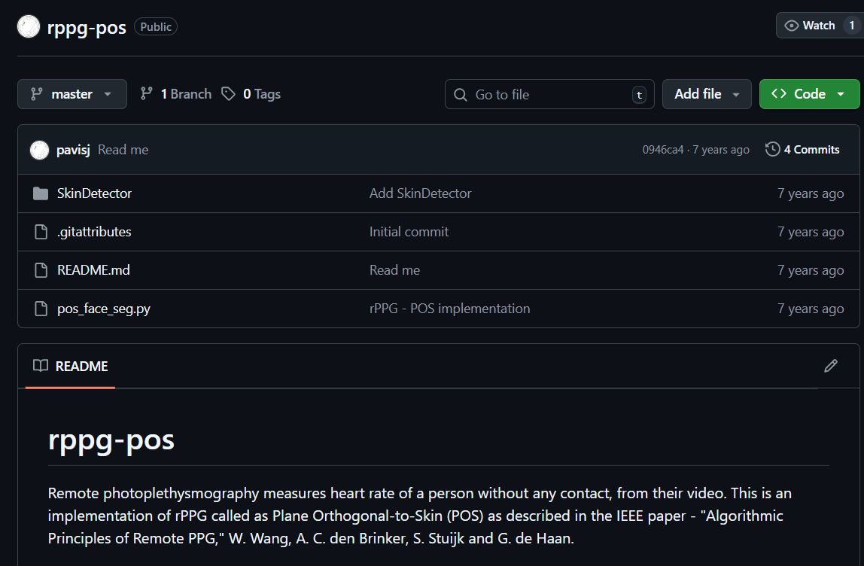
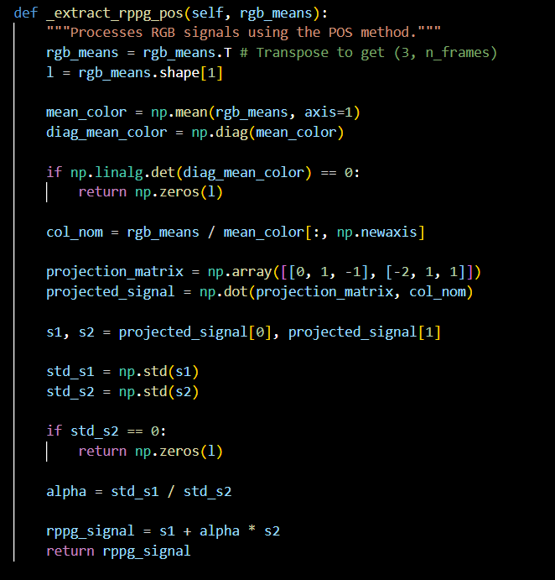

Slide 6
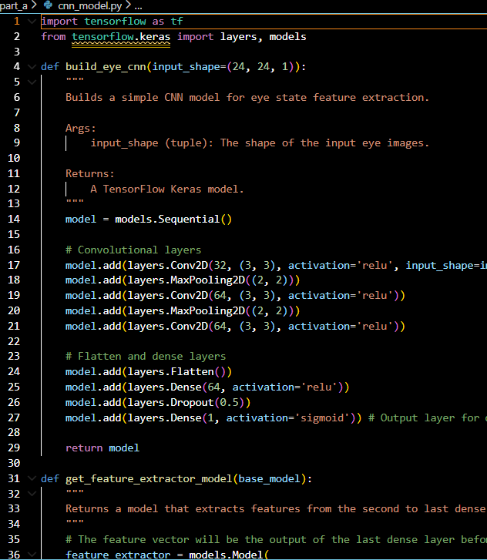
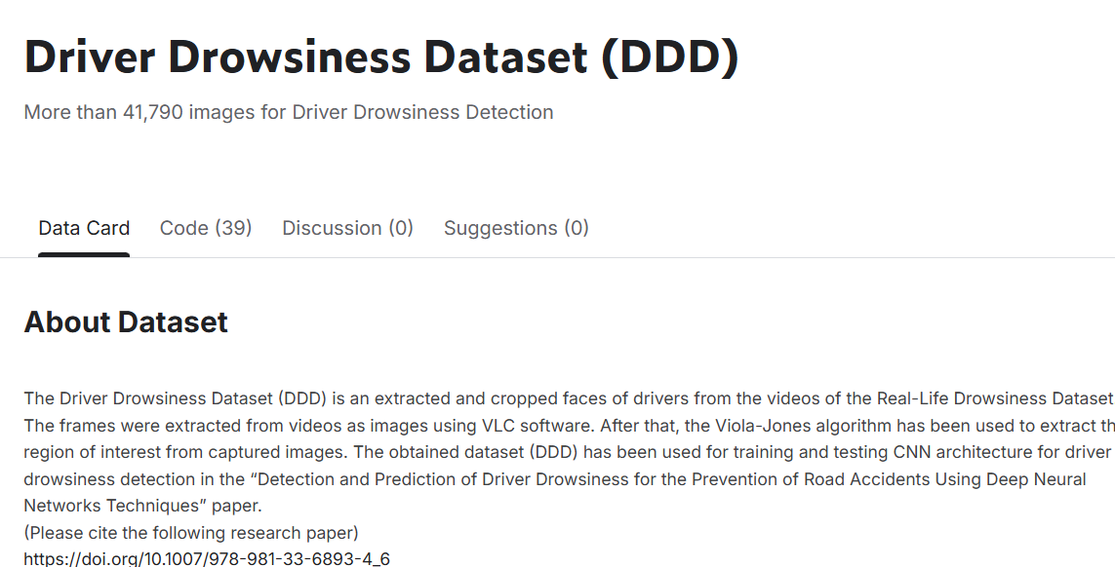
Last week using eye_CNN
Data alignment issue
Model lacks detail comparing to the original MTCNN in the paper
  Not open source
  Tried Haar-cascade+SLIC superpixel, but it’s not better than mediapipe

Slide 7
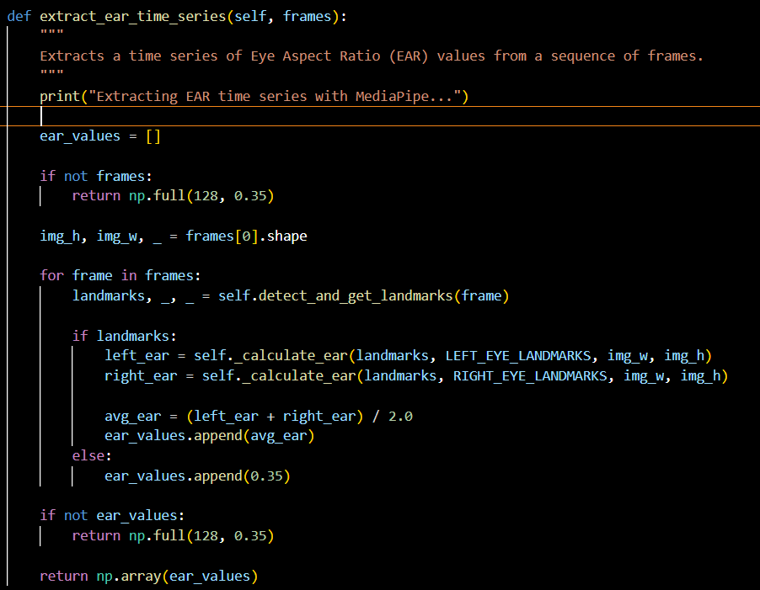
Updated EAR values using MediaPipe
Replacement update
Need testing from enhancement model portion

Slide 8
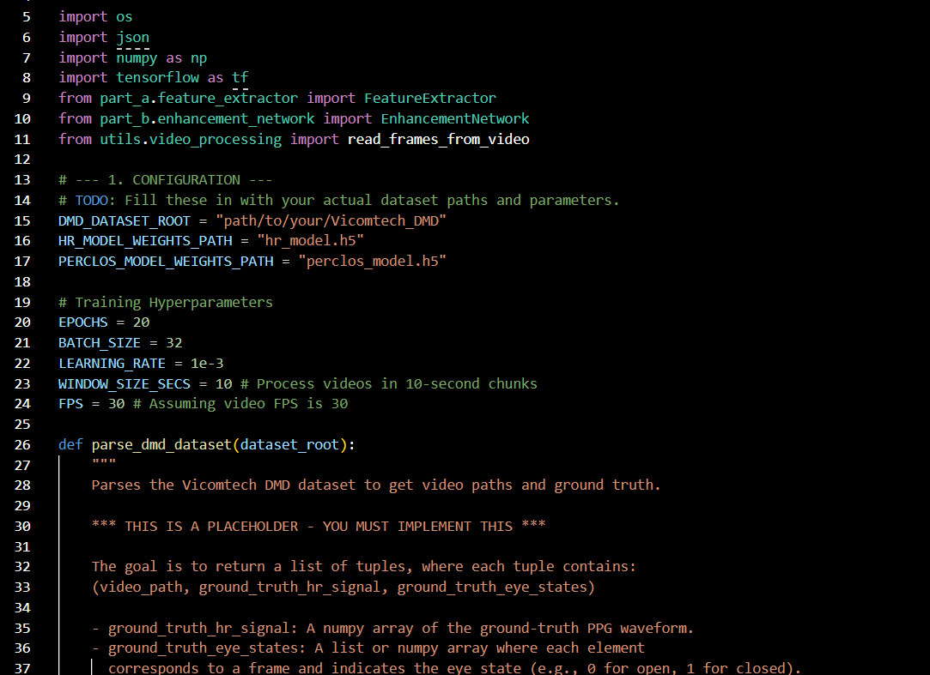
Training script for enhancement model
Part B
  Enhancement_network
    Fundamental structure rework
    Data length alignment
    Training script dev. for Enhancment_network(need training)
      Issue encounter, need server to run Vicomtech DMD
Input (from partA feature extractor)
  1D CNN rppg signal for HR
  1D from PERCLOS
Output
  HR value
  PERCLOS value

Slide 9
Thank you for listening
Q&A session

